Slide 1
STERLING
E-COMMERCE BUSINESS INSIGHT

Slide 2
HANNAH KIHARA NWAFOR CHARLES ANASTACIA NABOSU BABAJIDE AFENI OLAYEMI OLASEHINDE
GROUP 3 PROJECT MEMBERS

Slide 3
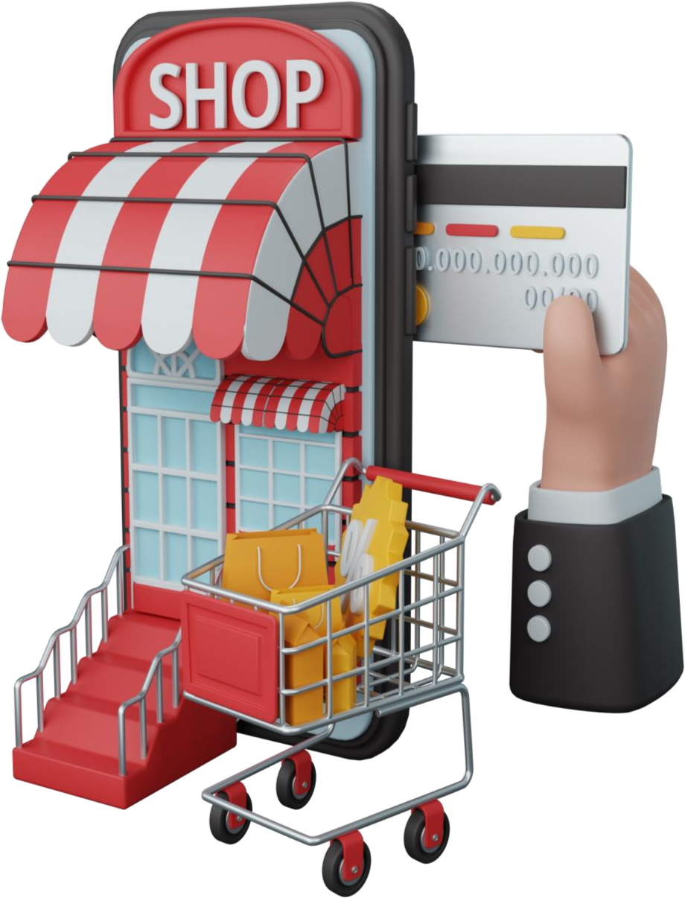
STERLING E-COMMERCE CUSTOMER BEHAVIOUR
From the Dashboard, Sterling Enterprise has made a total of 231.1 Million Dollars from their total sales so far by selling a total of 851.6 thousand goods across all categories.
The Pie charts show that their male customers purchase more goods than their female customers, However, their female customers generate generate more funds for the company despite ordering less goods than the male customers.

Slide 4

Average revenue
The Dashboard shows the average revenue generated by the business in terms of gender. It shows the female customers generate more funds on an average across all regions except the North-East Zone.
The Dashboard also shows that company experienced a surge in purchase between November and December 2021 probably due to the festivities during that period, followed by a sharp decline between January and febuary 2022.

Slide 5

Product Category
In terms of product category, Mobile and tablets appears to be the highest selling product followed by Appliances and Entertainment in that order. However, Books, School and Education don’t seem to be doing so well. To improve sales of books, Education and school, I suggest we partner with higher institutions ,develop an e-library that has a compilation of all our books, grant access to students and adopt a yearly subscription pattern Or we convert our books to e-books, pre-load them on our mobiles and tablets and upsell.

Slide 6
The dashboard shows that the most preferred payment method is bank Alfalah.
PAYMENT METHOD

